Slide 1
Personal items
Basic 1 – Unit 3b – Interesting Products

Slide 2
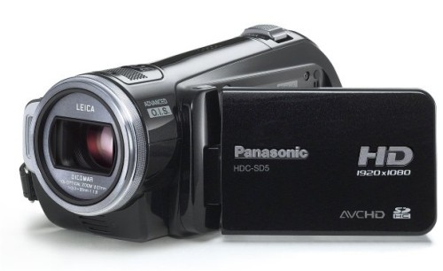
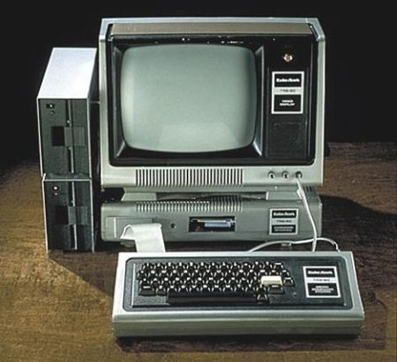
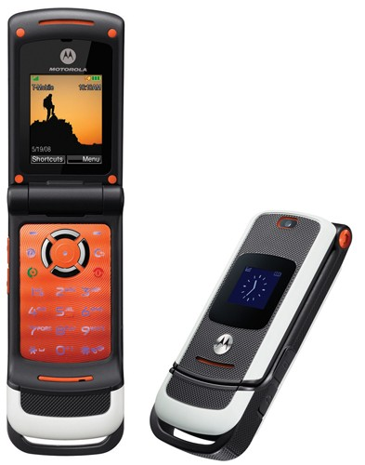
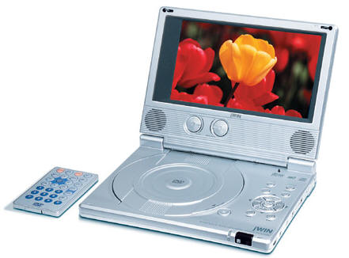
Panasonic - $ 250.00
HP Computer - $500.00
Sony DVD player- $ 690.00
Motorolla- $60.00

